Slide 1
Unit 1
INTRODUCTION

Slide 2
UNIT 1 Syllabus
Introduction to data and Data Science :
• What is Data Science?
What is Data?
Getting Help
• The Data Science Process
• Types of Data Science Questions
• Experimental Design
• Download data from different sources and explore them.

Slide 3
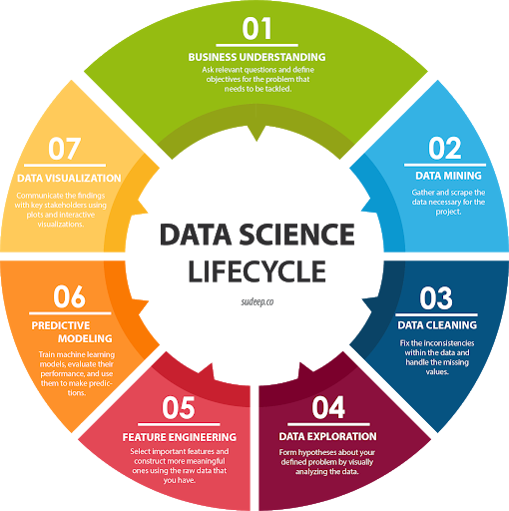

Slide 4
Prerequisites for Data Science(you must know)
1. Machine Learning
Machine learning is the backbone of data science. Data Scientists need to have a solid grasp of ML in addition to basic knowledge of statistics.
2. Modelling
Mathematical models enable you to make quick calculations and predictions based on what you already know about the data. Modelling is also a part of Machine Learning and involves identifying which algorithm is the most suitable to solve a given problem and how to train these models.

Slide 5
3. Statistics
Statistics are at the core of data science. A sturdy handle on statistics can help you extract more intelligence and obtain more meaningful results.
4. Programming
Some level of programming is required to execute a successful data science project. The most common programming languages are Python, and R. Python is especially popular because it’s easy to learn, and it supports multiple libraries for data science and ML.
5. Databases
A capable data scientist needs to understand how databases work, how to manage them, and how to extract data from them.

Slide 6
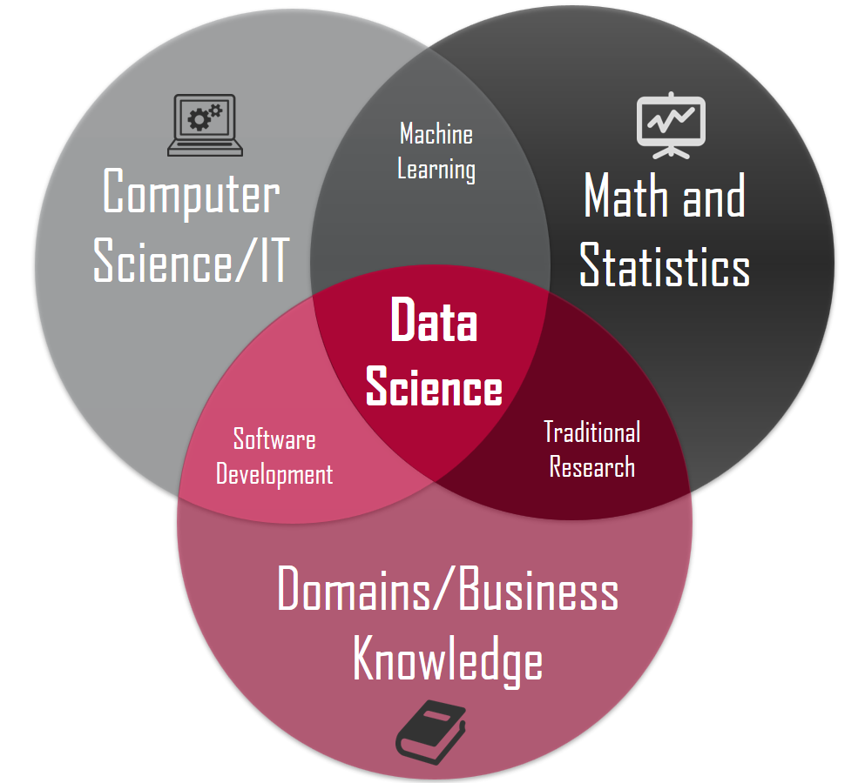

Slide 7
Job Opportunities in Data Science Field
Data science offers you the opportunity to focus on and specialize in one aspect of the field. Here’s a sample of different ways you can fit into this exciting, fast-growing field.
Data Scientist
Job role: Determine what the problem is, what questions need answers, and where to find the data. Also, they mine, clean, and present the relevant data.
Skills needed: Programming skills (SAS, R, Python), storytelling and data visualization, statistical and mathematical skills, knowledge of Hadoop, SQL, and Machine Learning.

Slide 8
Data Analyst
Job role: Analysts bridge the gap between the data scientists and the business analysts, organizing and analyzing data to answer the questions the organization poses. They take the technical analyses and turn them into qualitative action items.
Skills needed: Statistical and mathematical skills, programming skills (SAS, R, Python), plus experience in data wrangling and data visualization.

Slide 9
Data Engineer
Job role: Data engineers focus on developing, deploying, managing, and optimizing the organization’s data infrastructure and data pipelines. Engineers support data scientists by helping to transfer and transform data for queries.
Skills needed: NoSQL databases (e.g., MongoDB, Cassandra DB), programming languages such as Java and Scala, and frameworks (Apache Hadoop).

Slide 10
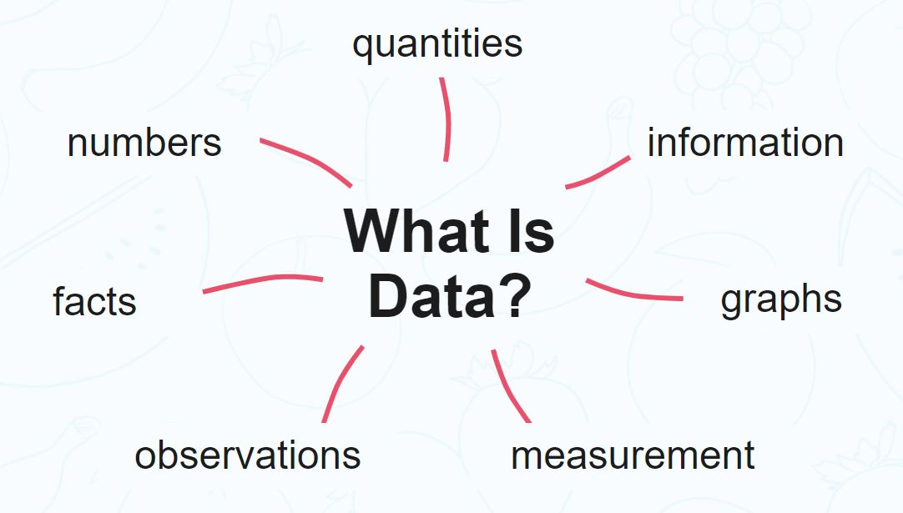
Understanding Data
Data can be texts or numbers written on papers, or it can be bytes and bits inside the memory of electronic devices, or it could be facts that are stored inside a person’s mind.
Data is factual information used as a basis for reasoning, discussion , calculation and decision making.

Slide 11
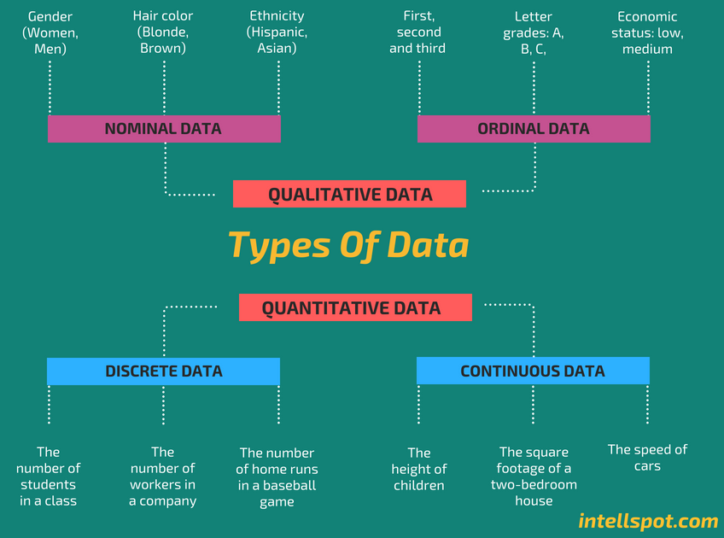
Types of Data

Slide 12
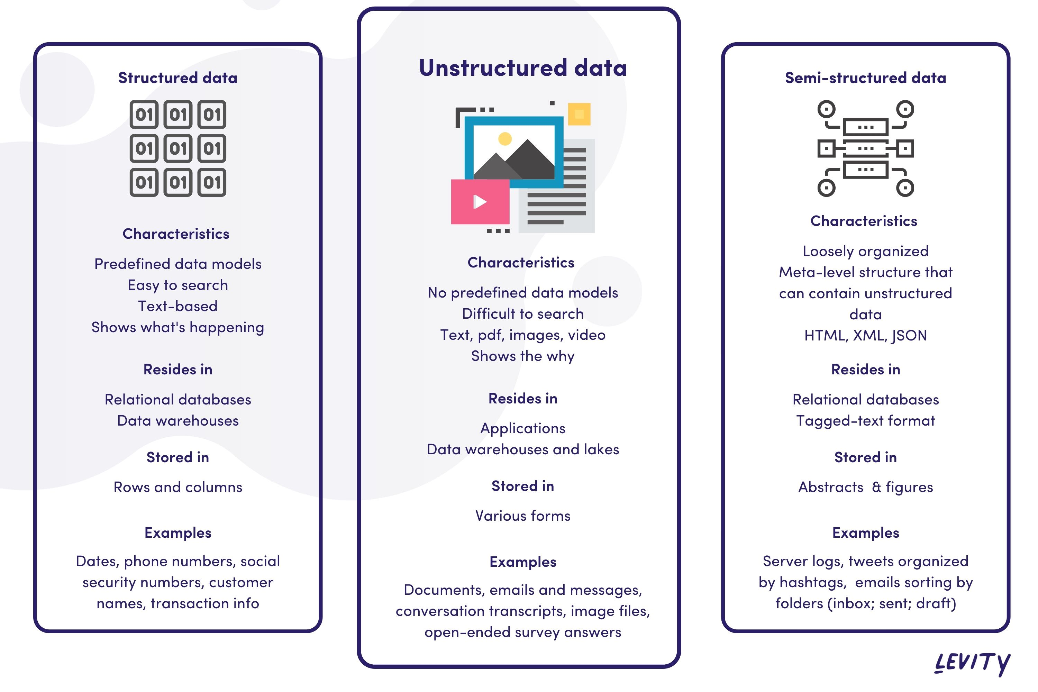
Categories of Data

Slide 13
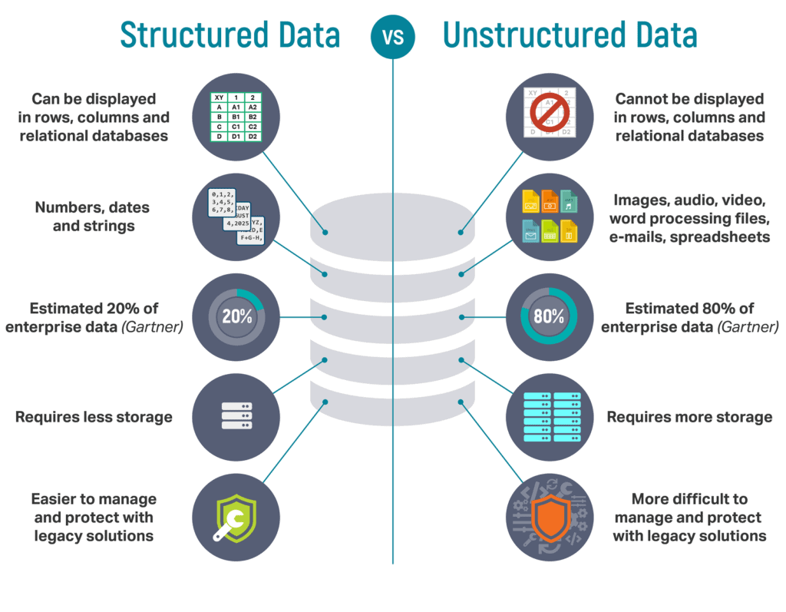
Structured Vs Unstructured Data

Slide 14
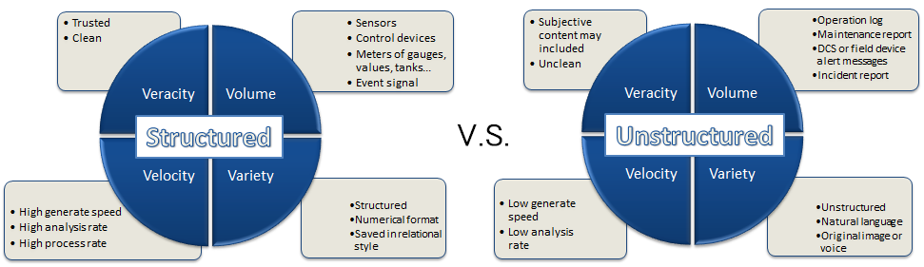

Slide 15
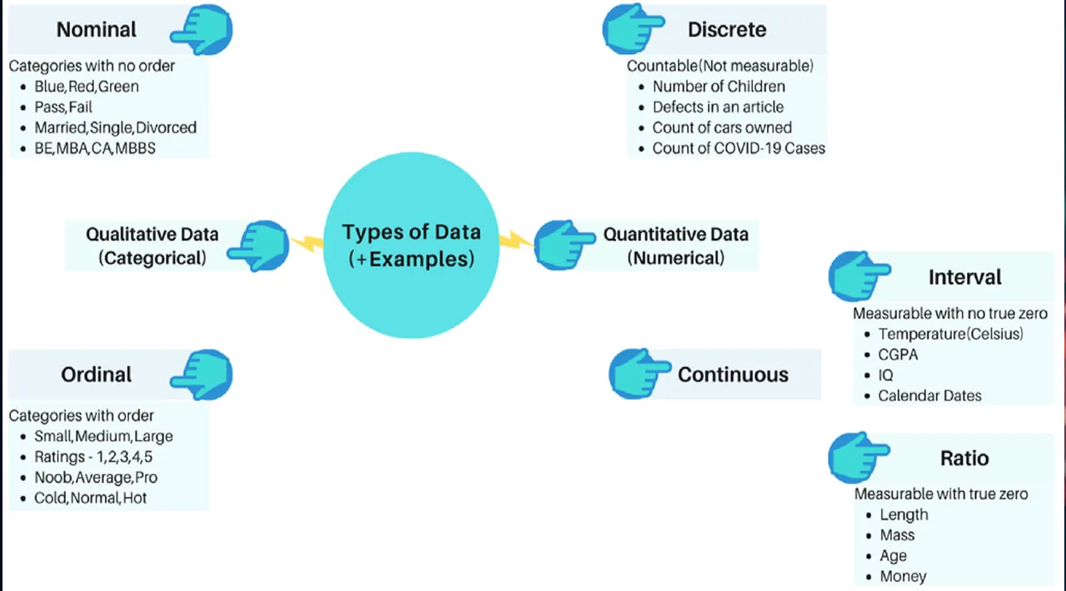

Slide 16
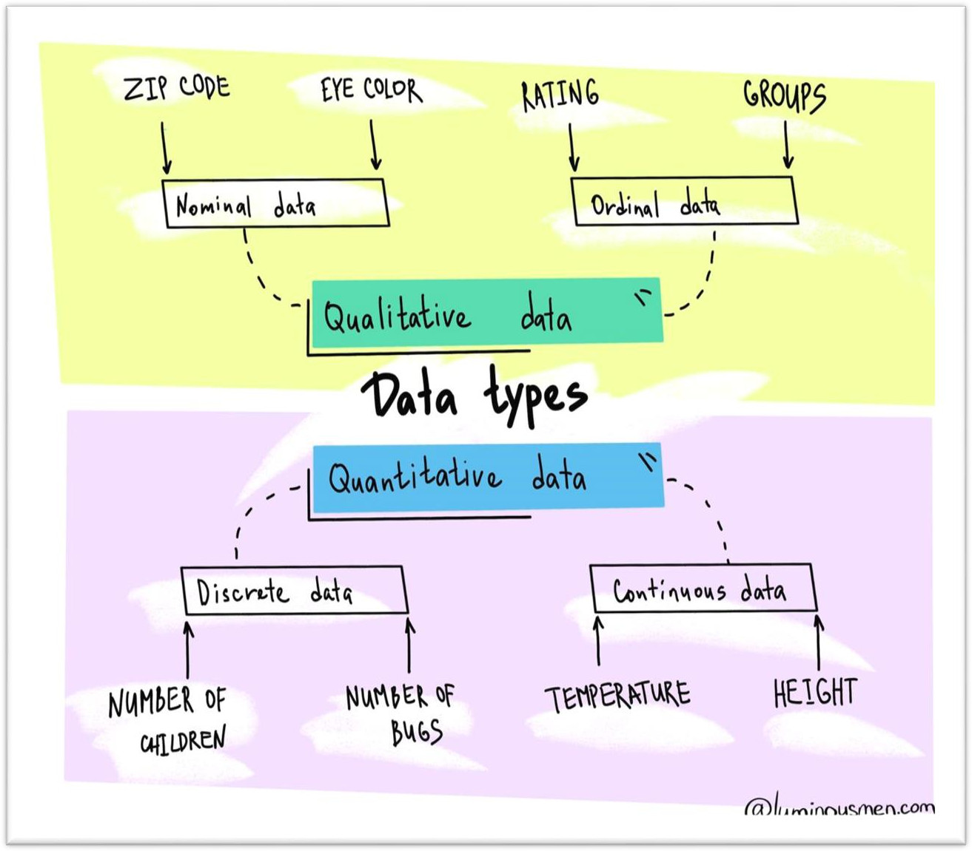

Slide 17
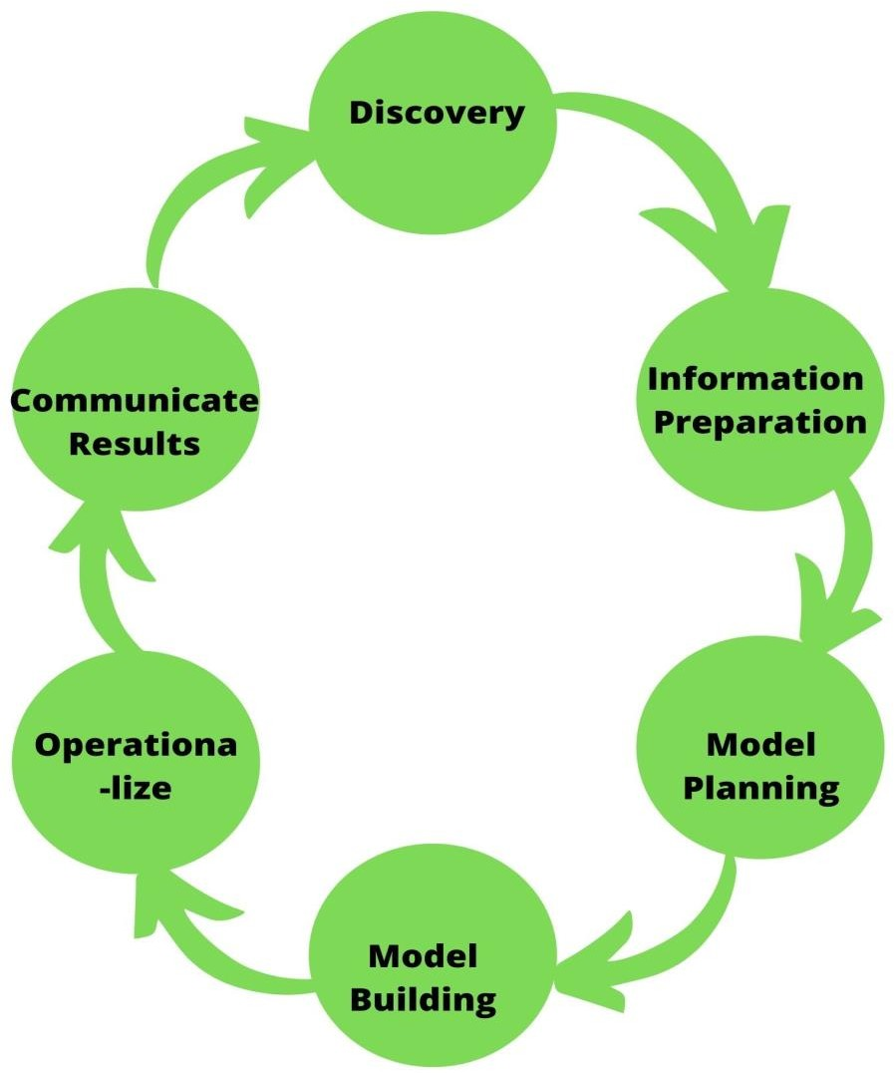

Slide 18
Discovery
To begin with, it is exceptionally imperative to get the different determinations, prerequisites, needs and required budget-related with the venture.
You must have the capacity to inquire the correct questions like do you have got the desired assets.
These assets can be in terms of individuals, innovation, time and information.
In this stage, you too got to outline the trade issue and define starting hypotheses (IH) to test

Slide 19
Information Preparation
In this stage, you would like to investigate, pre-process and condition data for modelling.
You’ll be able to perform information cleaning, changing, and visualization.
This will assist you to spot the exceptions and build up a relationship between the factors.
Once you have got cleaned and arranged the information, it’s time to do exploratory analytics on it.

Slide 20
Model Planning
Here, you may decide the strategies and methods to draw the connections between factors. These connections will set the base for the calculations which you may execute within the following stage. You may apply Exploratory Data Analytics (EDA) utilizing different factual equations and visualization apparatuses.

Slide 21
Model Building
In this stage, you’ll create datasets for training and testing purposes. You may analyse different learning procedures like classification, association, and clustering and at last, actualize the most excellent fit technique to construct the show

Slide 22
Operationalize
In this stage, you convey the last briefings, code, and specialized reports. In expansion, now a pilot venture is additionally actualized in a real-time generation environment. This will give you a clear picture of the execution and other related limitations.

Slide 23
Communicate Results
Presently, it is critical to assess the outcome of the objective. So, within the final stage, you recognize all the key discoveries, communicate to the partners and decide in the event that the outcomes about the venture are a victory, or a disappointment based on the criteria created in Stage 1.

